Slide 1


MediAI Expert
AI-Powered Medical Diagnosis Expert System
A web-based expert system that simulates human medical diagnostic reasoning through foundational symbolic AI techniques

Slide 2

The Medical Diagnosis Challenge
The Problem
Our Solution
Medical diagnosis requires extensive knowledge, pattern recognition, and logical reasoning. Human experts spend years developing these capabilities, but access to specialist care remains limited in many regions.
MediAI Expert bridges the gap by encoding medical knowledge into a rule-based system that applies logical inference to symptom patterns, providing accessible diagnostic reasoning support.

Slide 3



What is MediAI Expert?
Symbolic AI Foundation
Medical Expert Simulation
Web-Based Platform
Rule-based knowledge representation and logical inference mechanisms
Accessible interface combining modern frontend with robust backend logic
Mimics diagnostic reasoning of human physicians through structured rules
This system demonstrates how foundational AI concepts—knowledge bases, forward chaining, and backward chaining—can be applied to create an intelligent diagnostic assistant that reasons through symptom patterns to identify potential ailments.

Slide 4
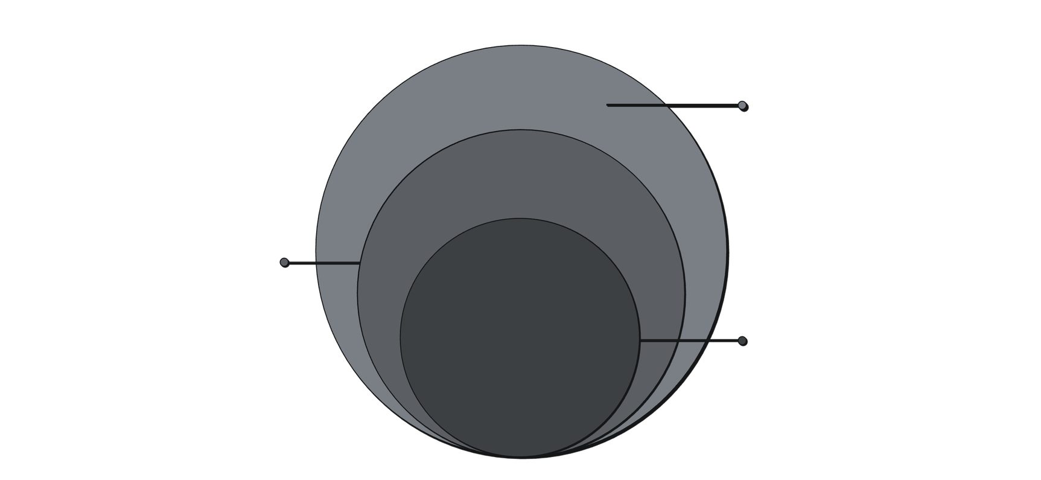
System Architecture
Data Layer
Knowledge base and session logs storage
Backend API
Python Flask REST endpoints and inference
Frontend SPA
HTML5, CSS3, JavaScript single-page app
01
02
03
Frontend Layer
Backend Layer
Data Layer
Single Page Application using HTML5, CSS3, and Vanilla JavaScript with asynchronous fetch() API calls
Python Flask framework exposing RESTful endpoints (/api/forward, /api/backward) and inference engine
Knowledge base rules and session logs stored in structured text files for audit and analysis

Slide 5

The Knowledge Base
Rule-Based System
The knowledge base encodes medical expertise as logical rules mapping symptom patterns to diagnostic conclusions. Each disease is represented as a conjunction of symptoms that must be present for diagnosis.
IF (Fever AND Cough AND Fatigue)
THEN Flu
IF (Fever AND Headache AND Joint Pain)
THEN Dengue
IF (Chest Pain AND Shortness of Breath)
THEN Cardiac Condition
This symbolic representation allows the system to reason through symptom combinations systematically, applying medical knowledge consistently across patient interactions.

Slide 6

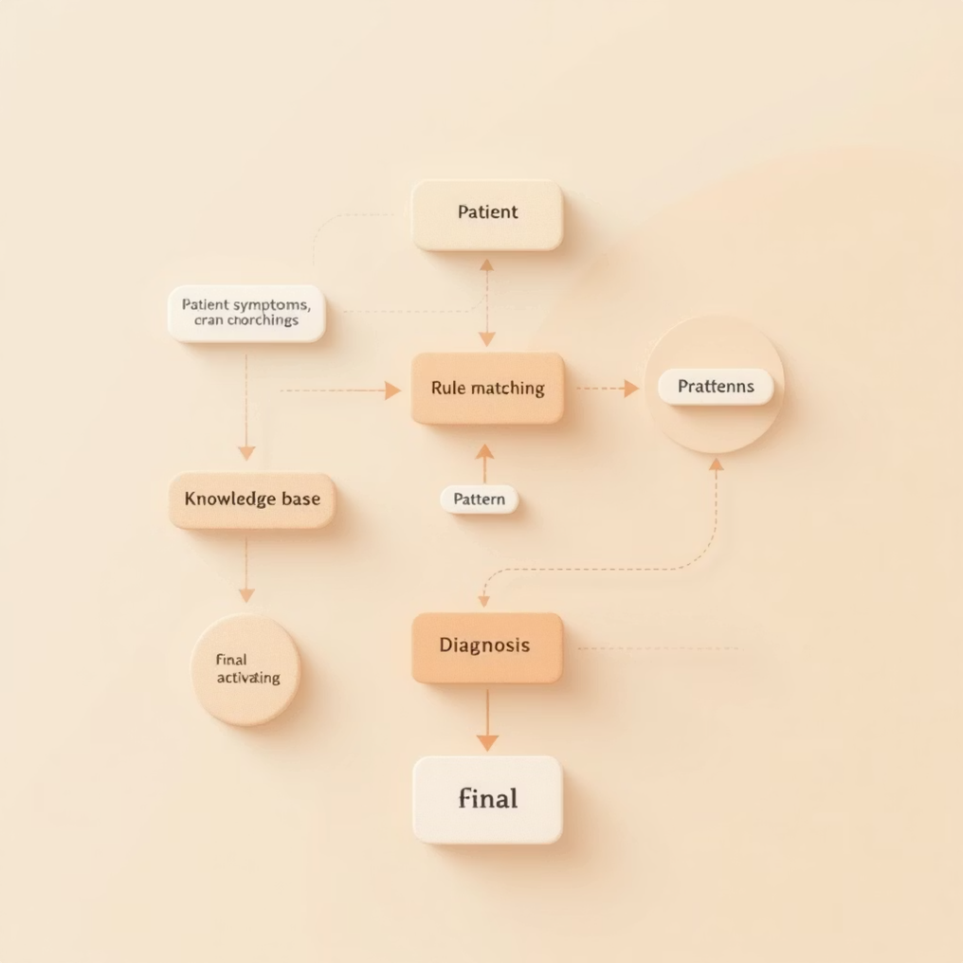





Inference Mechanism: Forward Chaining
Data-Driven Reasoning
User Input
Patient enters symptoms through interactive grid interface
Rule Matching
System searches knowledge base for matching patterns
Chain Activation
Applies rules sequentially, building toward diagnosis
Goal Reached
Diagnosis identified when symptom pattern matches disease rule

Slide 7
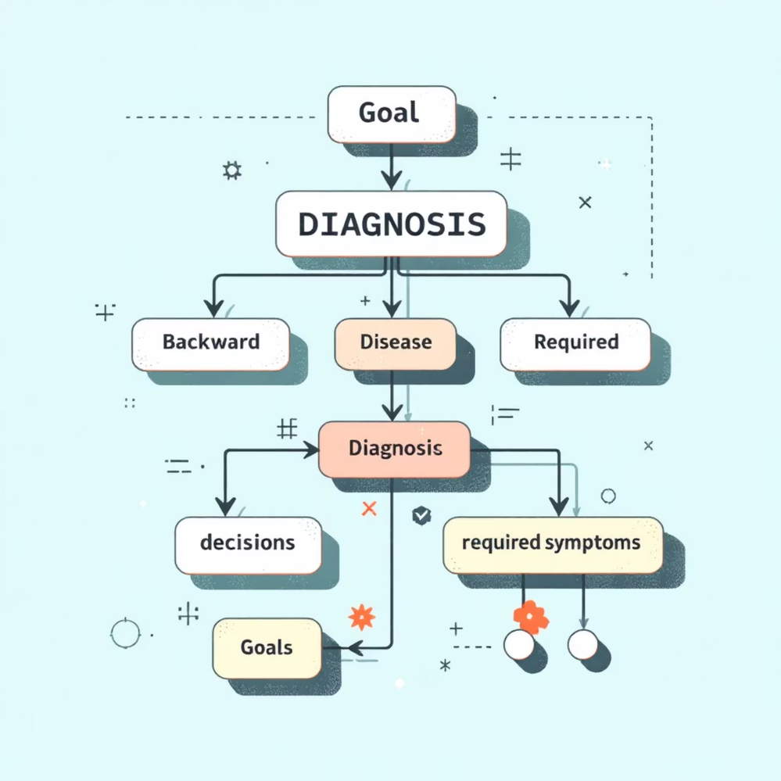
Inference Mechanism: Backward Chaining
Goal-Driven Reasoning
How It Works
User hypothesizes a potential disease
System identifies required symptoms for that diagnosis
Checks available patient symptoms against requirements
Confirms or rejects hypothesis based on symptom availability
This approach is particularly useful when clinicians have a working diagnosis and want to verify whether patient symptoms support it.

Slide 8
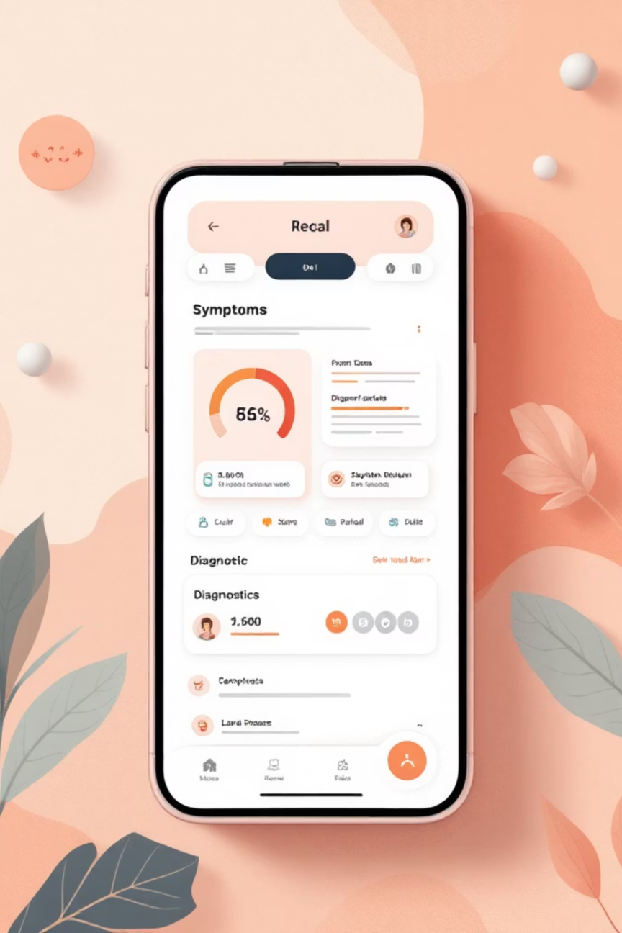
User Flow & Key Features
1
Patient Registration
Unique patient identifier creates session log for audit trail
2
Diagnostic Mode Selection
Choose between forward chaining (symptom-driven) or backward chaining (hypothesis-driven)
3
Interactive Symptom Grid
Dynamic interface for selecting symptoms from comprehensive medical taxonomy
4
Diagnostic Report
Step-by-step reasoning trace showing inference path and confidence levels

Slide 9


UI/UX Design & Audit Trail
Glassmorphism Design System
Data Logging & Audit
Premium glassmorphism UI with frosted glass effects
Dynamic HTML5 background animations
Clinical color palette: blues and pure whites
Inter font for optimal readability
Seamless SPA transitions via fetch() API
Session logs stored in patient-named .txt files
Complete reasoning trace for each diagnosis
Timestamped entries for regulatory compliance
Plain-text format for easy analysis

Slide 10
Conclusion
Technical Achievement
Educational Value
Real-World Application
Demonstrates practical implementation of symbolic AI concepts in healthcare domain with clean architecture
Clear illustration of knowledge representation, forward/backward chaining, and inference mechanisms
Shows how foundational AI techniques can address practical medical diagnostic challenges
Questions & Discussion
Thank you for your time. I'm ready to discuss technical implementation details, design decisions, or potential extensions to this system.

